Slide 1
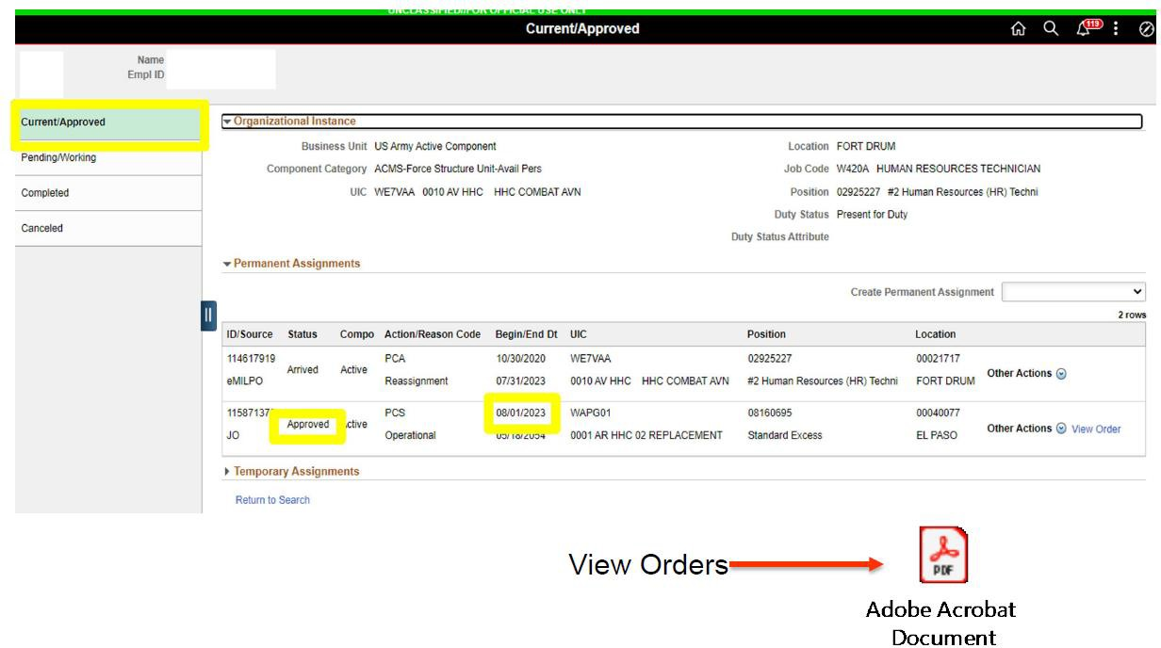
Absence Request
Service member has an approved assignment with a report date of 1 August 2023
One Soldier
One Record
One Army
2

Slide 2
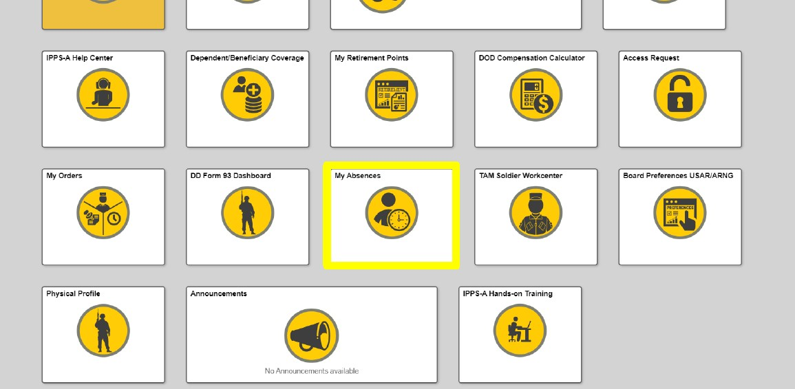
Absence Request (without House Hunting Absence)
ABSENCE REQUEST (WITHOUT HUNTING ABSENCE)
User, via Self-Service, will navigate to the Absence Request tile and submit for an Absence Request in Conjunction with PCS

Slide 3
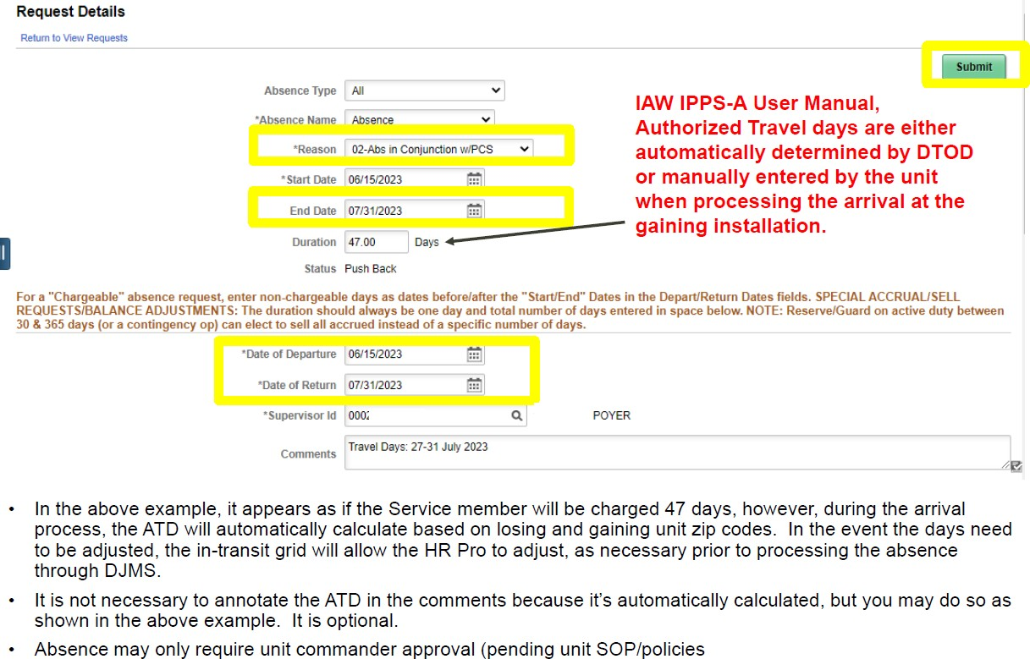
Absence Request (without House Hunting Absence)

Slide 4
A Request (with House Hunting Absence)
ABSENCE REQUEST (WITH HOUSE HUNTING)
User, via Self-Service, will navigate to the Absence Request tile and submit for an Absence Request in Conjunction with PCS

Slide 5
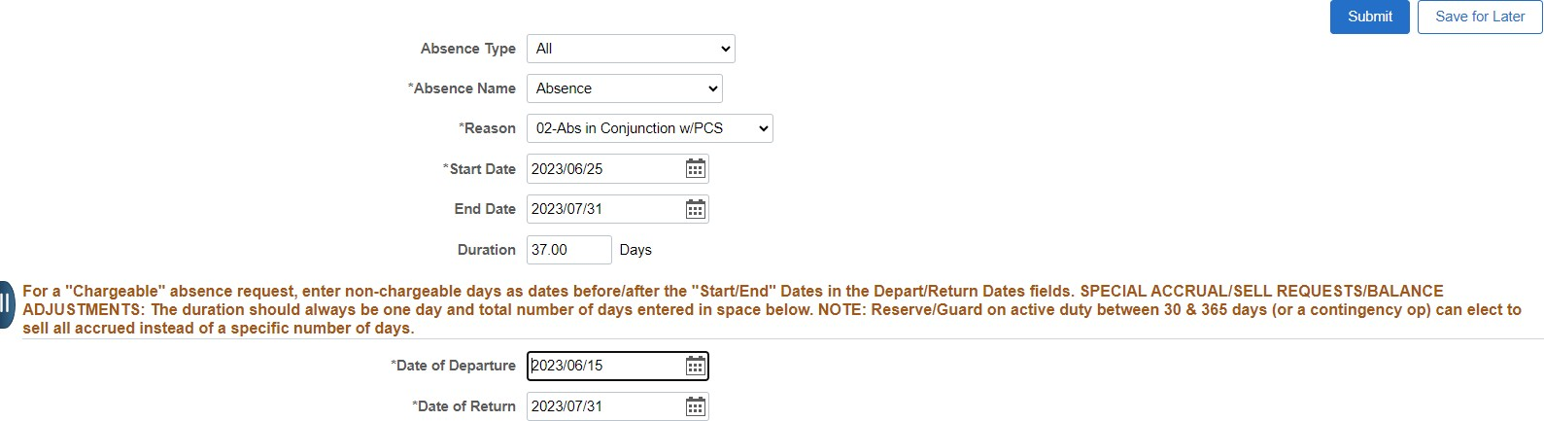
Absence Request (with House Hunting Absence)
Enter Chargeable days on top
Enter entire absence period
**Reminder**: Authorized Travel Days (ATD) will be automatically determined by Defense Table of Official Distance (DTOD) or manually entered by the unit when processing the arrival. The 37 chargeable days in the example above will adjust upon arrival to gaining unit.
Absence may only require unit commander approval (pending unit SOP/policies).

Slide 6
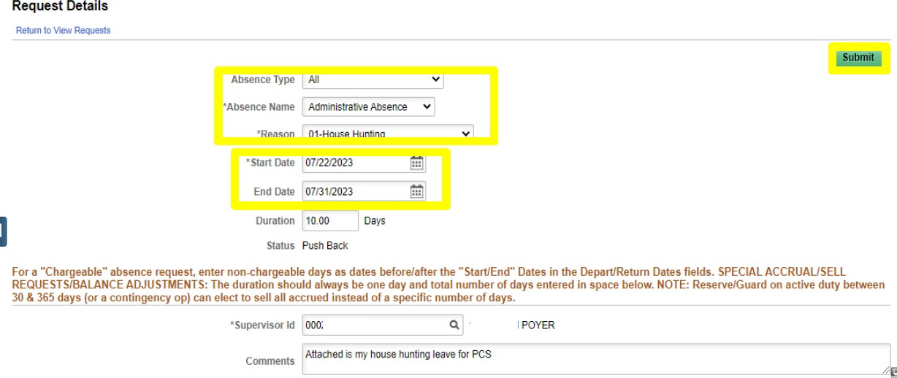
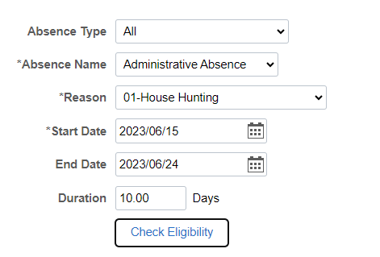
Absence Request (with House Hunting Absence)
Enter the House Hunting dates as shown above.
House Hunting must be entered before the absence in conjunction with PCS period and must be included inside the entire absence period annotated as shown in the previous slide.
Ensure the proper authority approves the House Hunting. Must be a commander LTC(O-5) or higher.

Slide 7
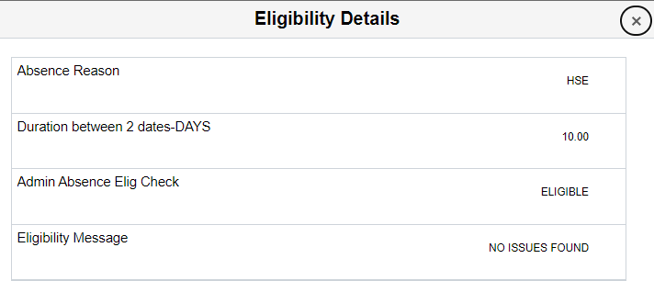

Absence Request Errors
Start and end date error means another absence is currently occupying the same dates. Fix the dates in the other absence before continuing with this one.
Forecast error means you must click the “Check Eligibility” button. Then click the “View Eligibility Details” to see if there is an error.
If you get no PCS assignment found, then you must put your PCS absence end date
to 1 day prior to your PCS orders report date.

